Slide 1
Social Networks in Game Of Thrones
Investigating how networks predict allegiances and storylines in fiction
Uffe Grøn Roepstorff s245109• Lovro Antic s235263• Oskar Karlsson s244771

Slide 2
Central Idea
What are we investigating?
Mapping character relationships & allegiances in Game of Thrones Books
3,563 named characters from a large fictional universe
Can we infer allegiances, conflicts and defining characteristics for Game Of Thrones Houses through Computational Social Science methods.
Why is it interesting?
Fictional networks as a lens for real-world network phenomena
Exploring Computational Social Science methods on a subject we have domain knowledge of.
Exploring potential and complications with webscraping
It’s fun

Slide 3
Dataset & Collection
Source
Game of Thrones Wiki
Web scraping via Python (BeautifulSoup + requests, URLLibParse for stability)
Method
Parse character pages
Extract attributes, allegiances, biographies
Clean + structure into CSV
Result
3,563
named characters
characters_enriched.csv
Name, ID, allegiances, affialtions
characters_bio.csv
Name, ID, History

Slide 4
Text to analyze
Source
Game of hrones Wiki
Web scraping via Python (BeautifulSoup + requests, URLLibParse for stability)
Method
Parse character pages
Extract attributes, allegiances, biographies
Clean + structure into CSV
Result
3,563
named characters
characters_enriched.csv
Name, ID, allegiances, affialtions
characters_bio.csv
Name, ID, History

Slide 5
Goals
Network Construction
Build character graph with allegiances as community labels; run community detection algorithms
TF-IDF Word Clouds
Compute TF-IDF per allegiance group; visualise distinctive vocabulary as word clouds
1
2
Real-World Comparison
Compare fictional network statistics (degree dist., clustering) to known social network models. Does the connections follow a pareto distribution.
LLM Relationship Extraction
Prompt LLMs to classify character relationships as collaborative or combative from biographies
Explore if houses make factions or are intertwined in conflicts
3
4

Slide 6
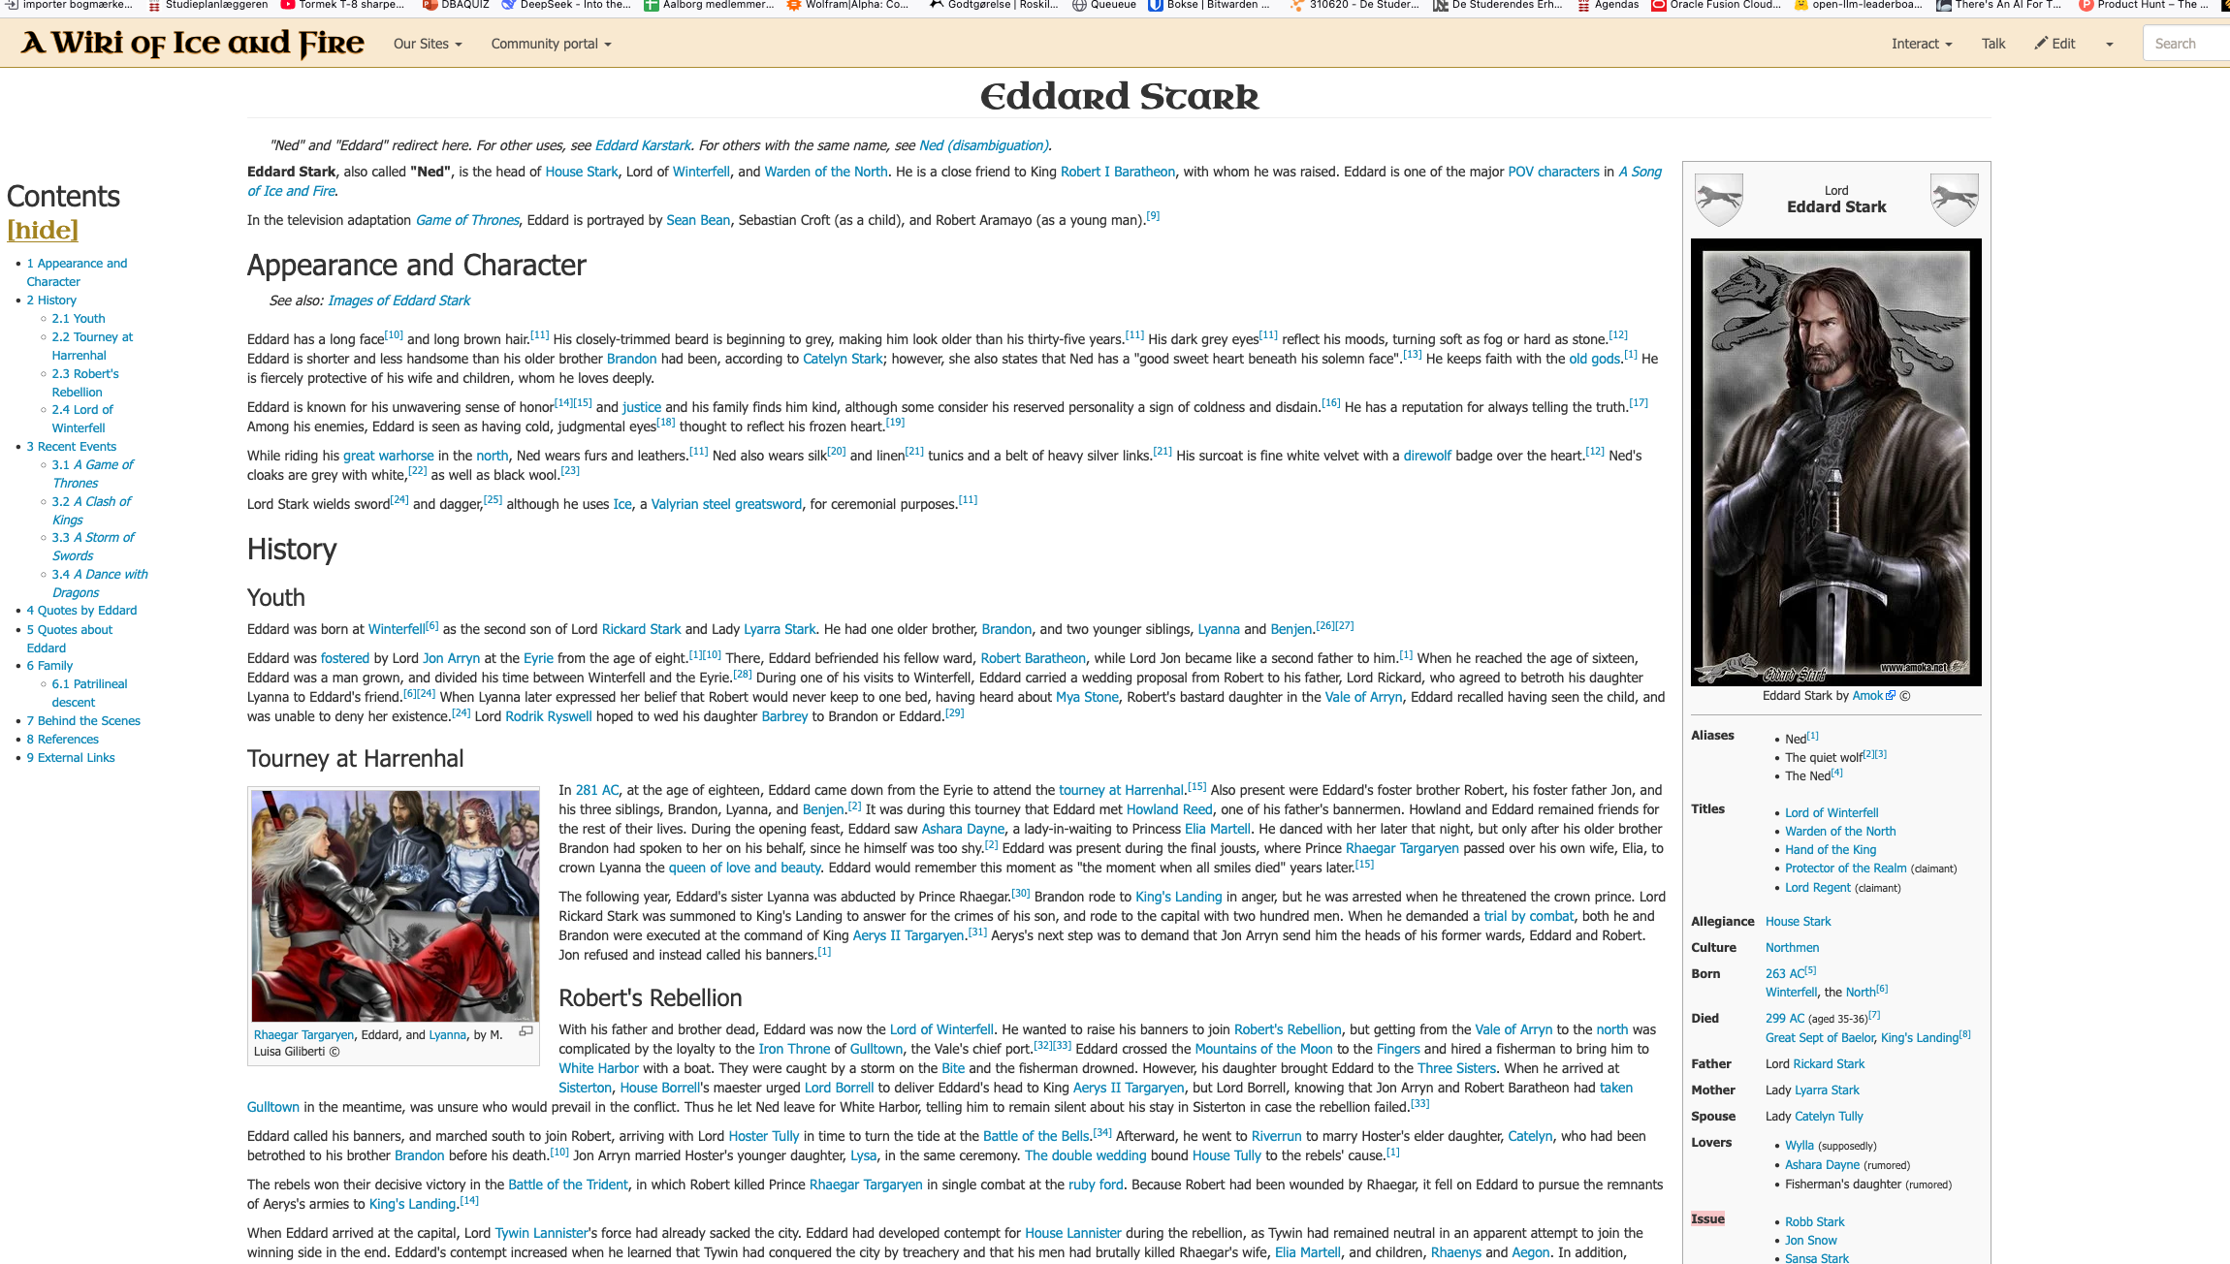
Text to analyze
Extracting character histories:
Exchanging names for ID’s for uniqueness.
Exploring relationships through LLM analysis hopefully.
Using a local LLM for reproducibility

Slide 7
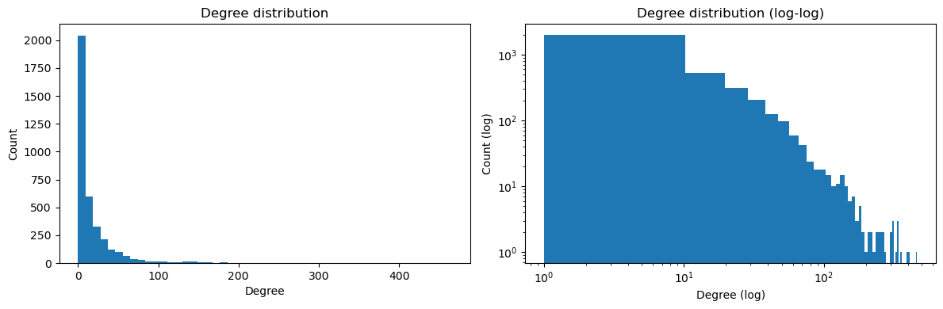
Preliminary Data Analysis
1.1 Mb
MB dataset size
3,689
rows (characters)
9
variables/columns
Node Attributes
Main: Name, ID, Affiliated, Allegiance, Bio
Additional: Father, Mother, Spouse, Lover, Issue
Additional are very incomplete, we might not use it for the final project
Network Stats (Preliminary)
Nodes: 3689
Edges: 36315
Avg. degree: 19.7
Median: 8

Slide 8
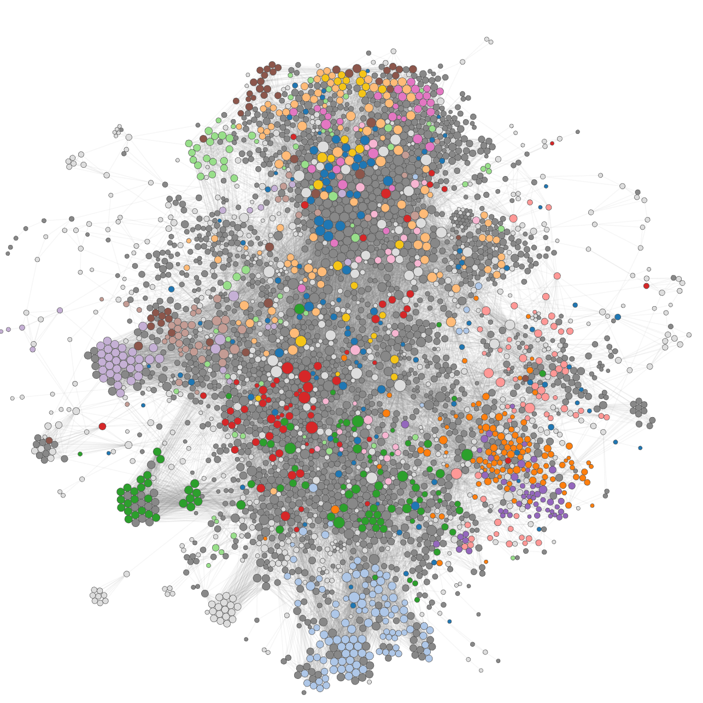
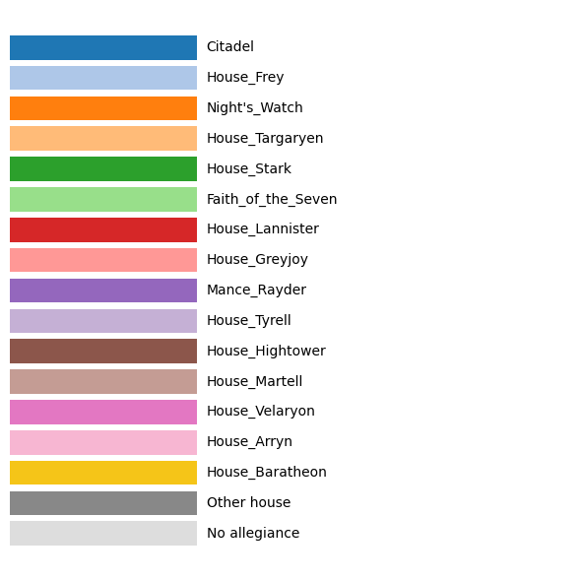
First graphs

Slide 9
Pipeline & Next Steps
Scraping
Network
TF-IDF
LLM Extraction
Compare w/ Real Networks
Explore Conflicts
Predict allegiances
Next Steps
Finalise network construction from allegiance data
Run LLM-based relationship extraction on corpus
Generate TF-IDF word clouds per allegiance group
Compare with real-world social networks
Prepare final visualisations and project website

